Slide 1


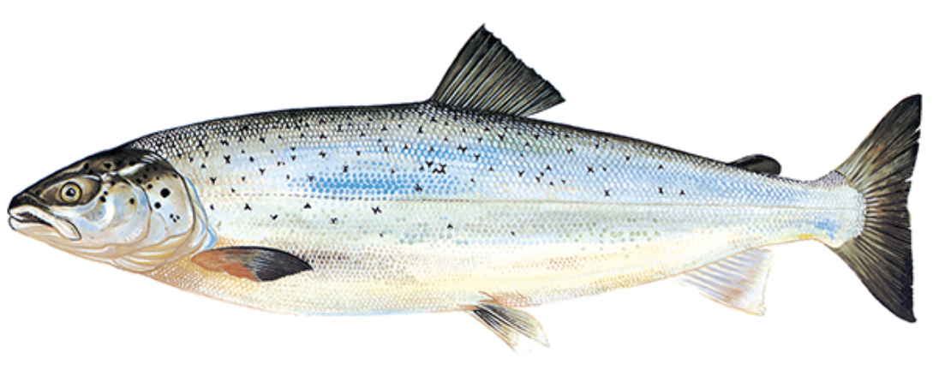
Aquaculture goal
Salmon production
Trout production
Sustainability indicators :
Lice
prevalence
MOM B
investigations
Protein retention
ratio
Escaped fish

